Slide 1

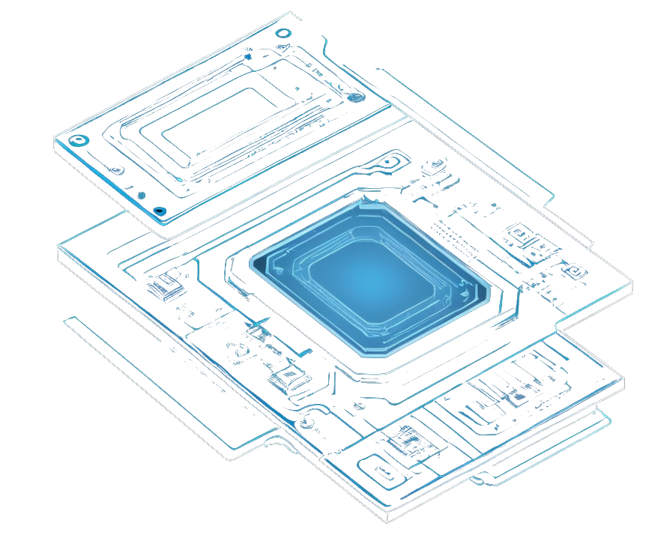

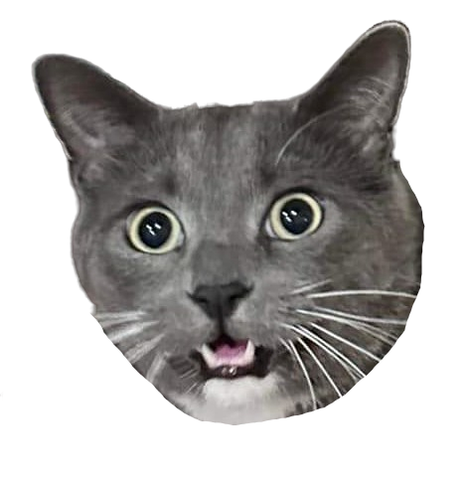


CATMEMES
OVERHAMRADIO
Slow Scan TV – Defcon 32

Slide 2



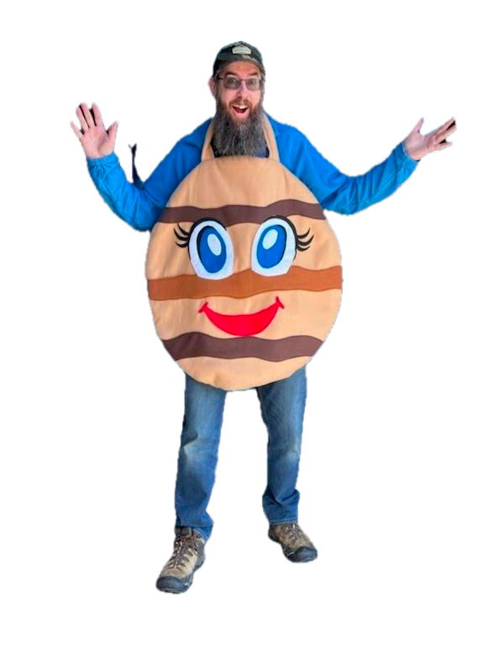



INTRO
I’m hamster
KD5WGW
electronics and ham radio nerd
yes I’m glad cookie season is over

Slide 3

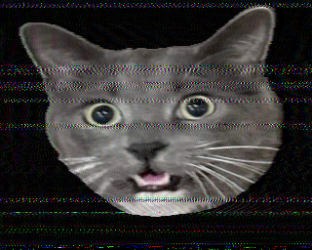
WHAT IS SSTV
Slow Scan TV is a collection of various encoding methods used to convert an image into a sound that can be transmitted and reconstructed at a distance
A single 320x256 image takes about 110 seconds to transmit, so this is not ‘live’ TV (aka Fast Scan TV) – just images

Slide 4

SSTV DEVELOPMENT
1957
COPTHORNE MACDONALD
Invented the first algorithm
1960s
SPACE IMAGES
USSR and NASA used forms of SSTV to beam back images
1968
LEGALIZED FOR HAMS
FCC allows ‘advanced’ class amateurs to broadcast SSTV
1990s
SOFTWARE DEVELOPED
Home PCs began to get software to encode/decode

Slide 5
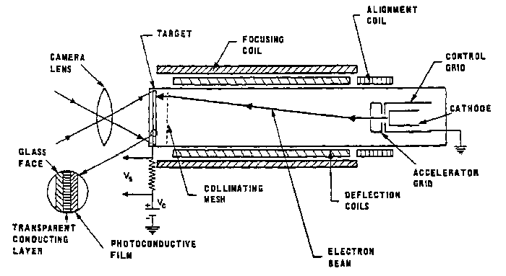
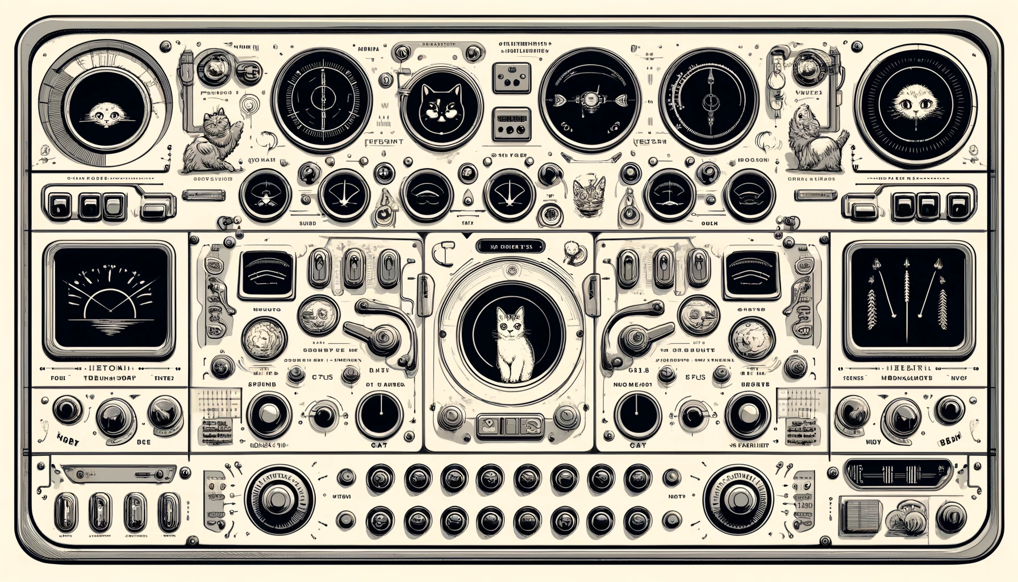
EARLY SSTV
Specialized hardware called a Vidicon tube was required to encode an image
Original was 120 lines, 120 pixels per line

Slide 6


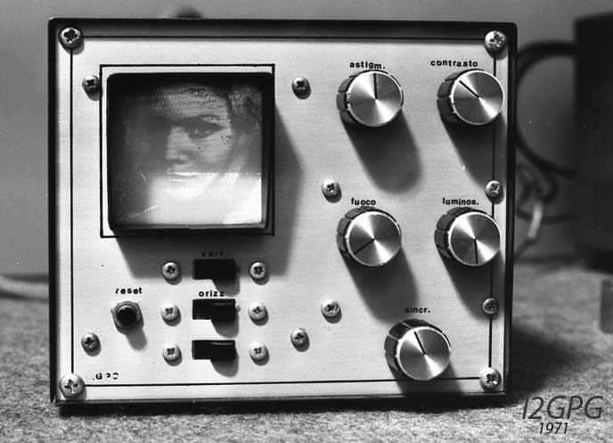
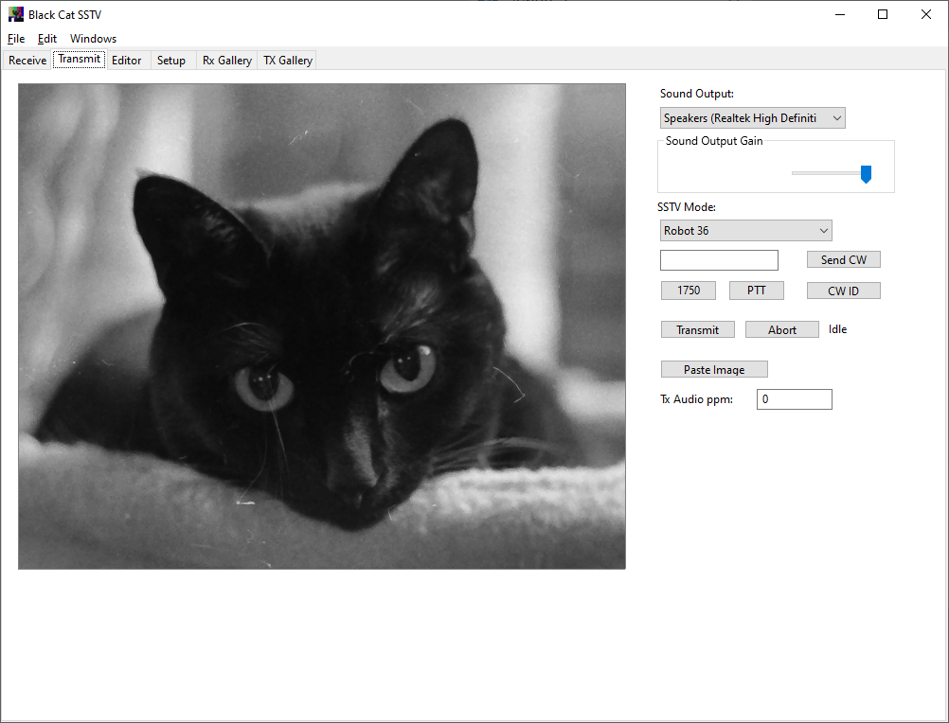

PERSISTENCE OF VISION
DIGITAL STORAGE
Early SSTV took advantage of the properties of CRT screens to display images. ‘Storage’ was via film cameras
As PCs became available, images could be decoded and saved via digital means

Slide 7
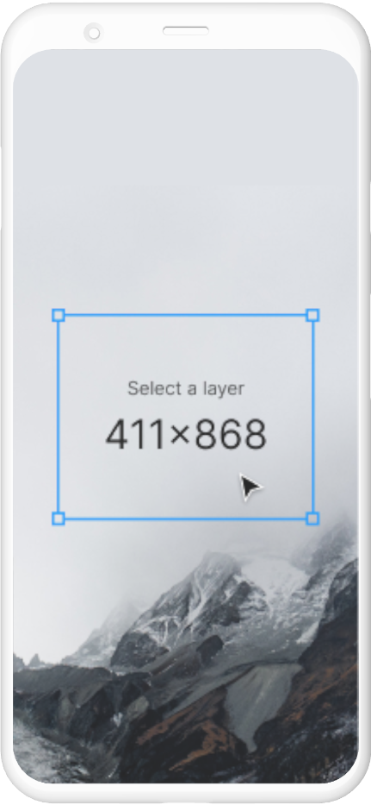
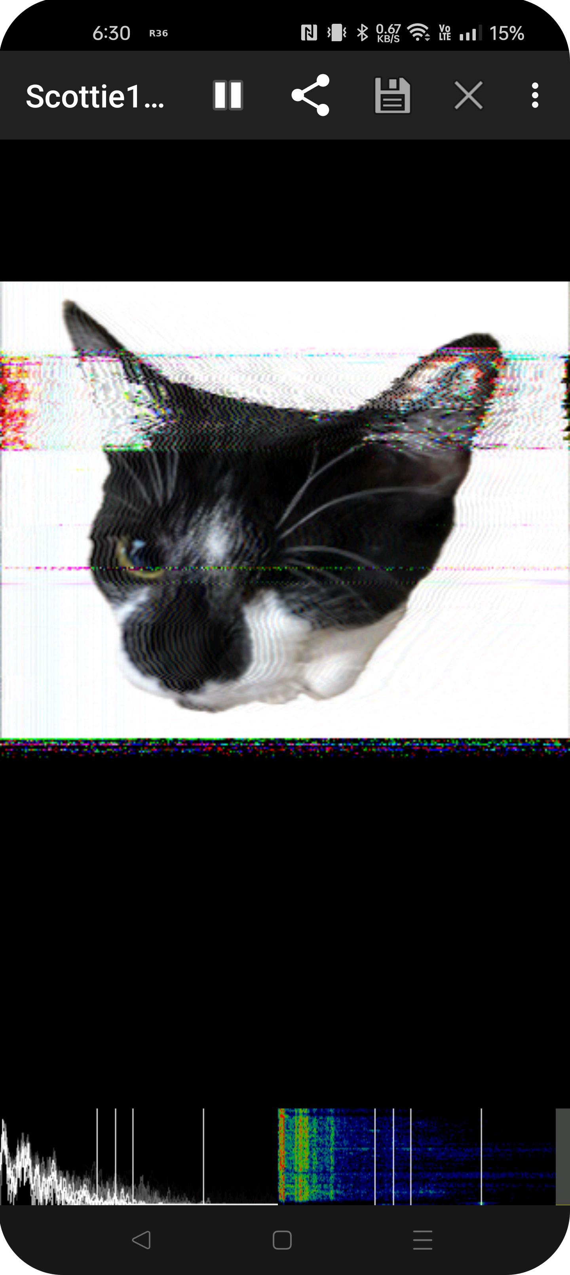
MODERN SSTV
Many free software packages exist to encode and decode SSTV
You can even encode and decode using your phone

Slide 8
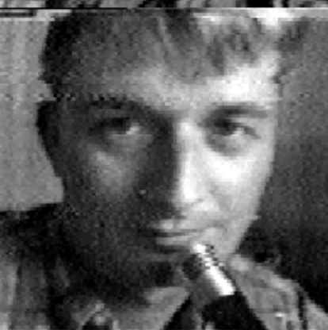
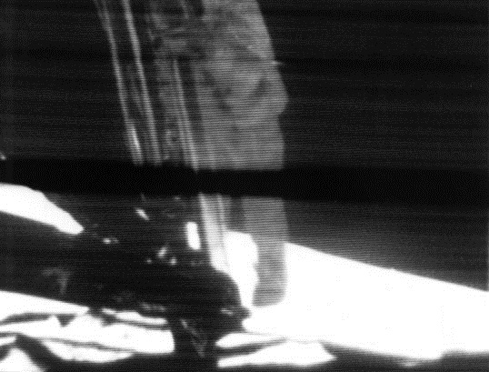

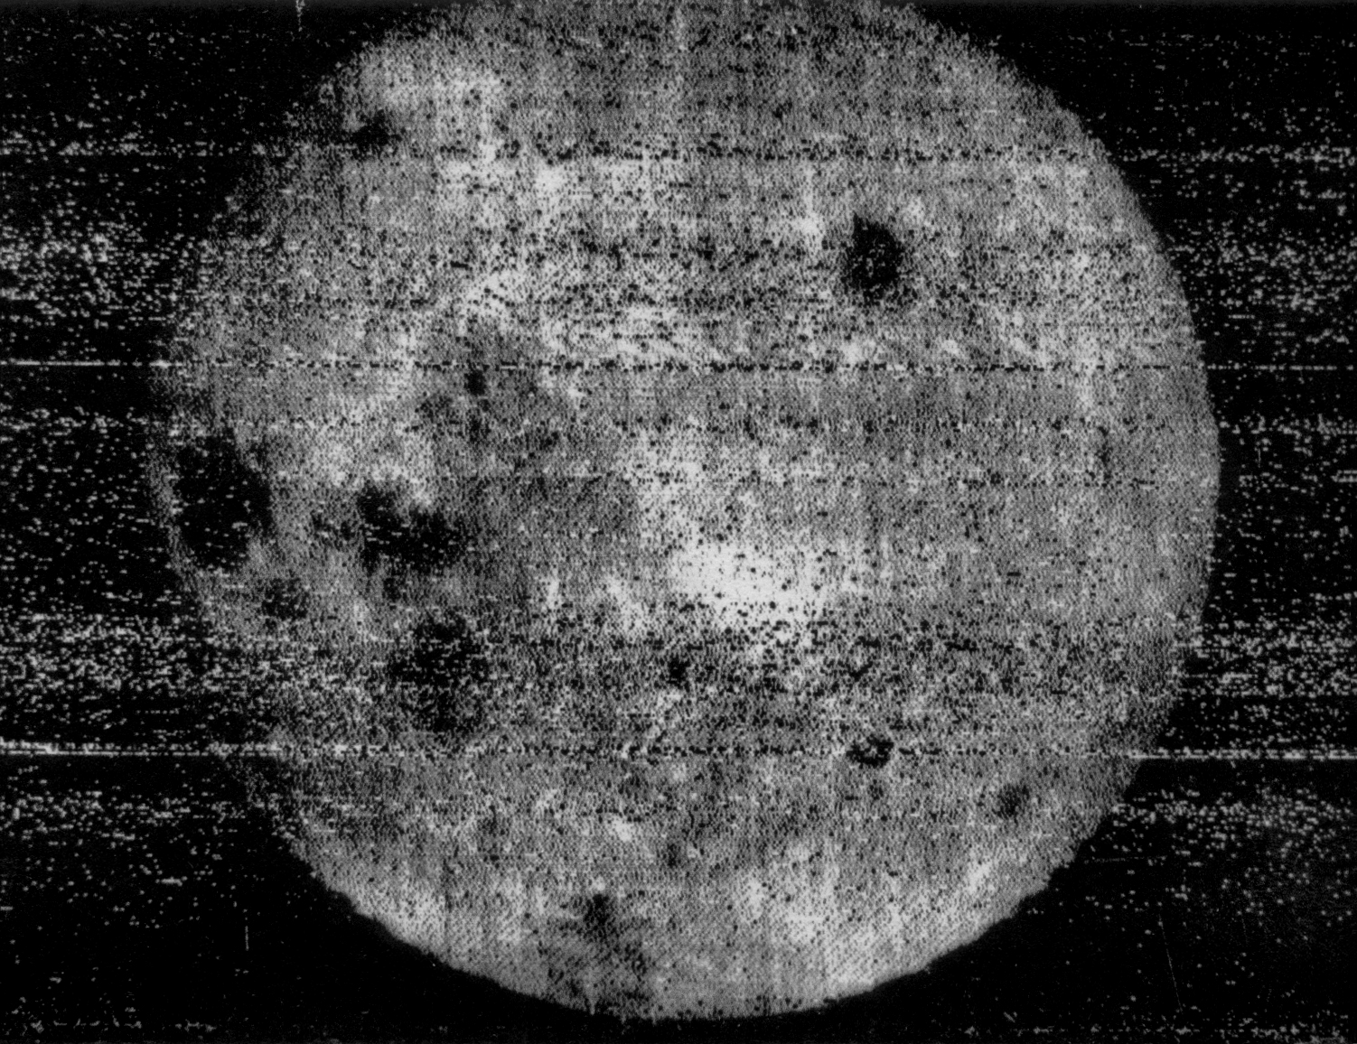
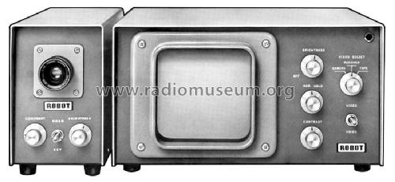
SSTV USAGE
1959
EARLY 1980s
Russian Luna 3 first images of the far side of the moon
Robot Research Corp develops commercial units
FIRST IMAGES
SPACE
APOLLO
COMMERCIAL
1958
1960s
Work was improved by hams over a 10 year period
NASA makes use of SSTV in space missions

Slide 9
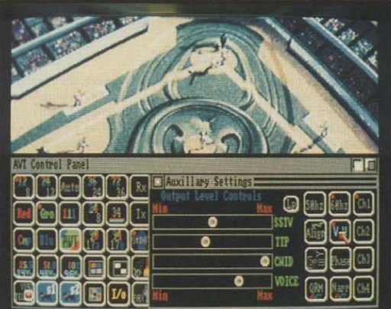
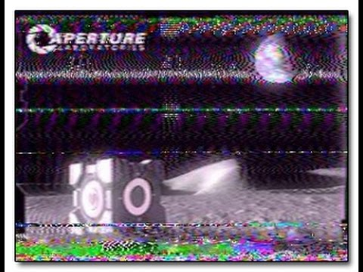
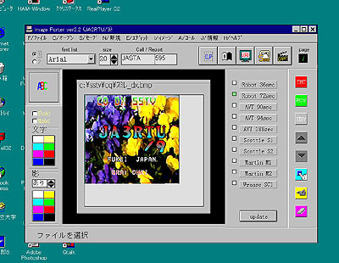
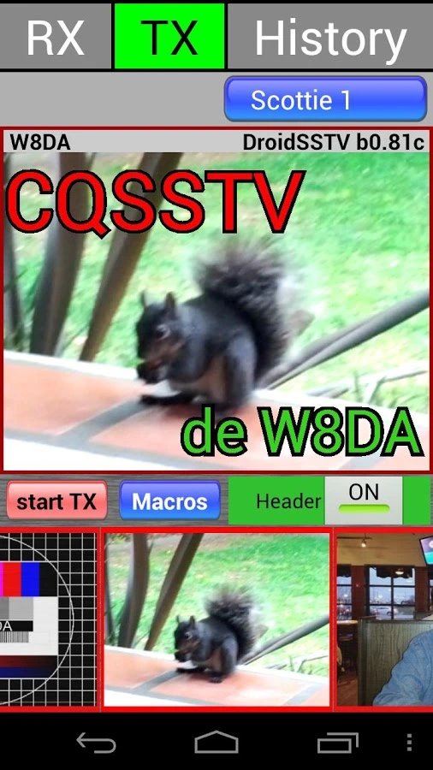
SSTV USAGE
1990s
2010s
Improved sound cards allow for software decoding
Phone applications become available for SSTV on the go
AMIGA
IBM PC
POP CULTURE
PHONE
1990
2007
Interface developed for Amiga computers - AVT
Valve uses hidden SSTV audio in game

Slide 10
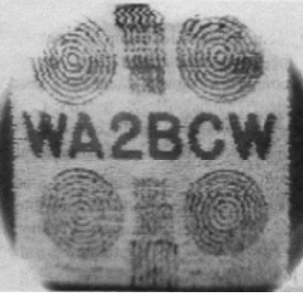
SSTV TECHNICALS
‘Fast Scan TV’ (broadcast television) is 3Mhz for black and white television or 6Mhz for color television
Total bandwidth for SSTV images is around 3khz
The first trans-Atlantic image

Slide 11

SSTV MODULATION
ANALOG SIGNAL
SSTV uses frequency modulation to encode brightness levels – higher frequencies are lighter, and lower are darker
COLOR ENCODING
For color modes, each line is sent three times, for the Red, Green, Blue elements.
Some schemes send YCrCb instead, which is chroma values for RGB
TIMING AND SYNC
Each line has a specific timing, with a sync tone either in the middle or end of the line

Slide 12
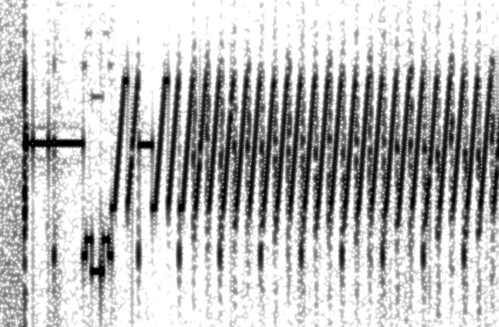
TRANSMISSION COMPONENTS
HEADER
SCANLINE
A calibration header starts a message
A Vertical Interval Signaling (VIS) code in the header identifies the encoding type
Each line of the image is sent sequentially, ordered from left to right
A sync pulse is at the end or middle of each line depending on mode

Slide 13
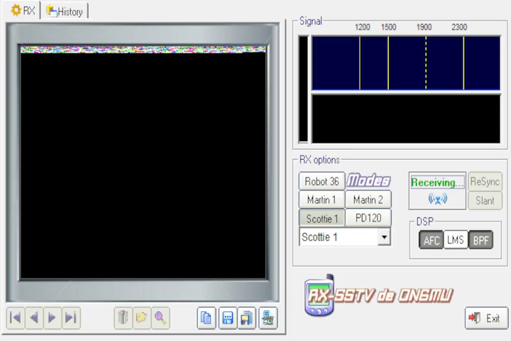
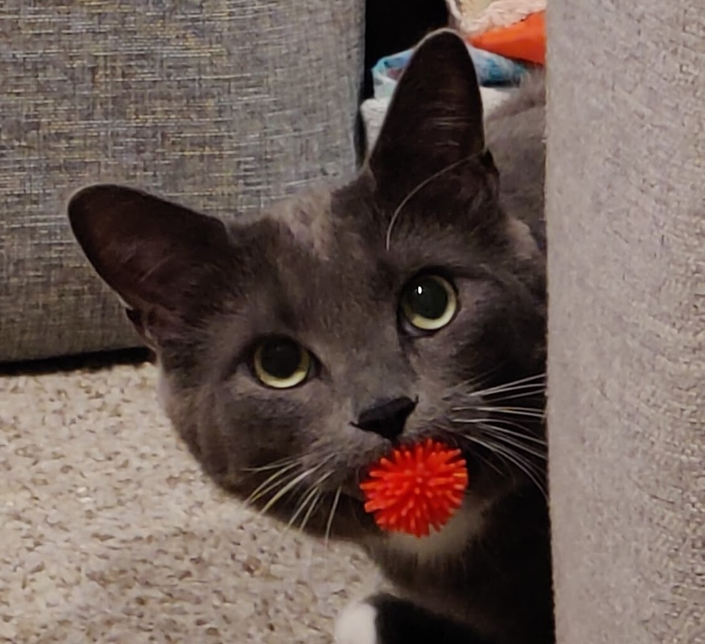
SSTV TEST
SOURCE

Slide 14

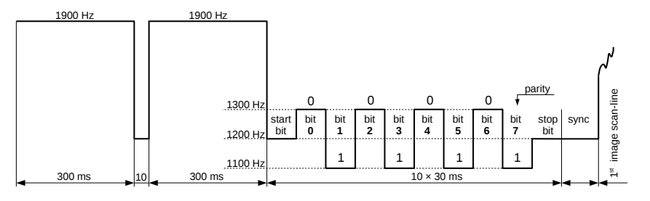
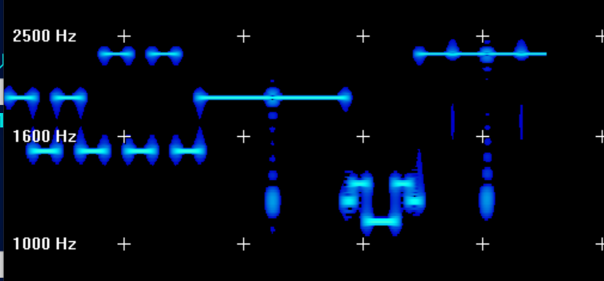
HEADER
The header starts with two 1900hz tones that are 300ms long with a 10ms break
Following that, there are 8 bits, with a start and stop bit. Bit 8 is a parity bit
This VIS code identifies what format the image is going to be transmitted in
This is typical of most modes in current use

Slide 15
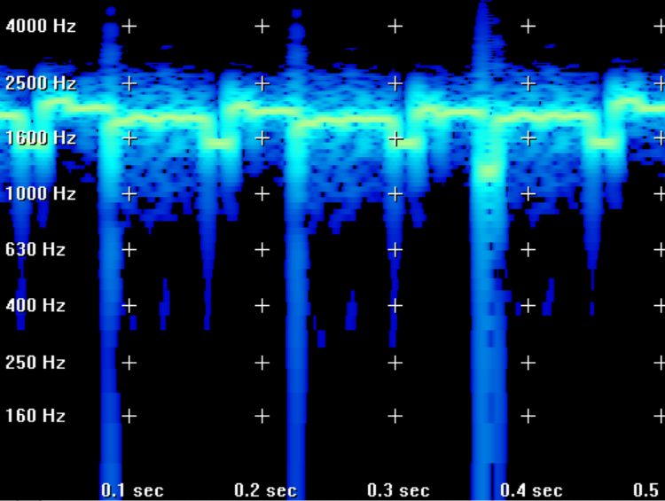
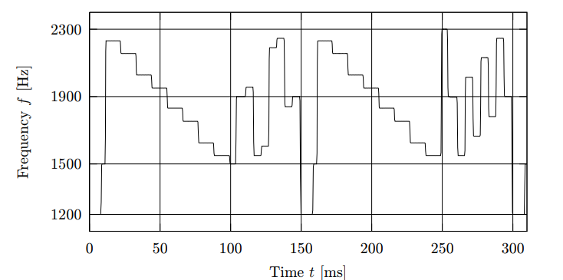
SCAN LINES
Scan lines encode the image information for each line as a function of the received frequency
At the end of each line, a sync pulse of 1200hz is sent
Some modes put the sync pulse in the middle of the scanline instead
Color images send three scan lines per actual scan line to encode the RGB value of the line
Very early color images were actually multiple black and white images, each with a color filter on the camera – a very manual process

Slide 16

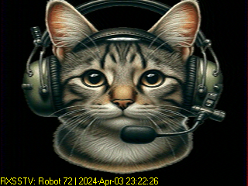
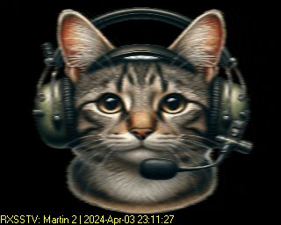
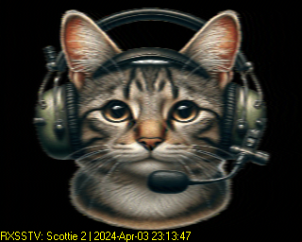
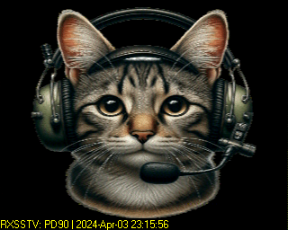
MODES IN BRIEF
Robot
Martin
Scottie
PD
Robot Research Corp
Martin Emmerson G3OQD
Eddie Murphy GM3SBC
Paul Turner / Don Rotier
YCrCb instead of RGB
Compat with B&W
Async transfer
Sync pulses can be lost
Improved on Robot Up to 320x256
Simplified color sync
Stations are synced
Improved on Martin
Same image quality
Adds a DX mode
Most popular in NA
YCrCb color
Reduced xmit time
800x600 – 5 minutes

Slide 17
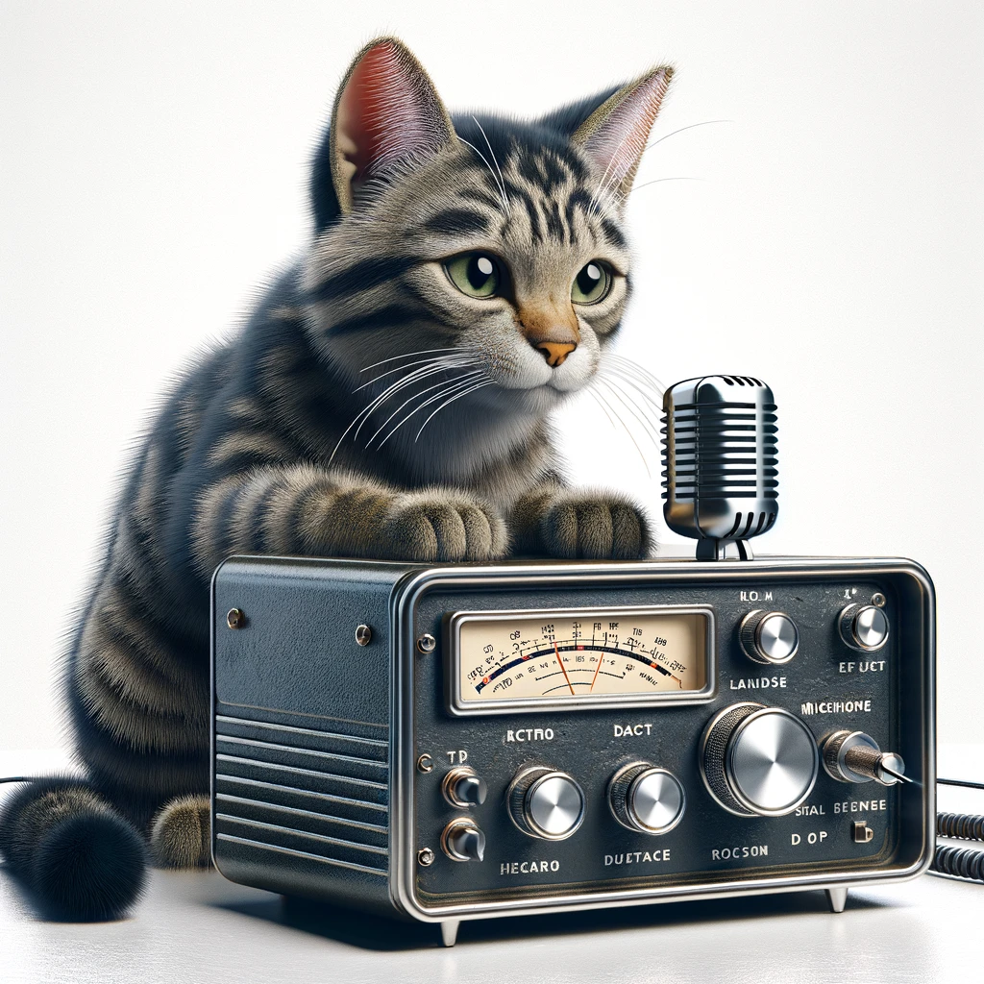
OTHER MODES
Tons of experimental/abandoned modes
MSCAN TV
Interlaced transmission
Kenwood FAST FM
Like Robot, but with odd parity
Built-in to some handsets
MP, MR, ML
VIS code extended to 16 bits
Sync is narrowband
Martin HQ
YCrCb encoding
Full specification never detailed
Many more!

Slide 18
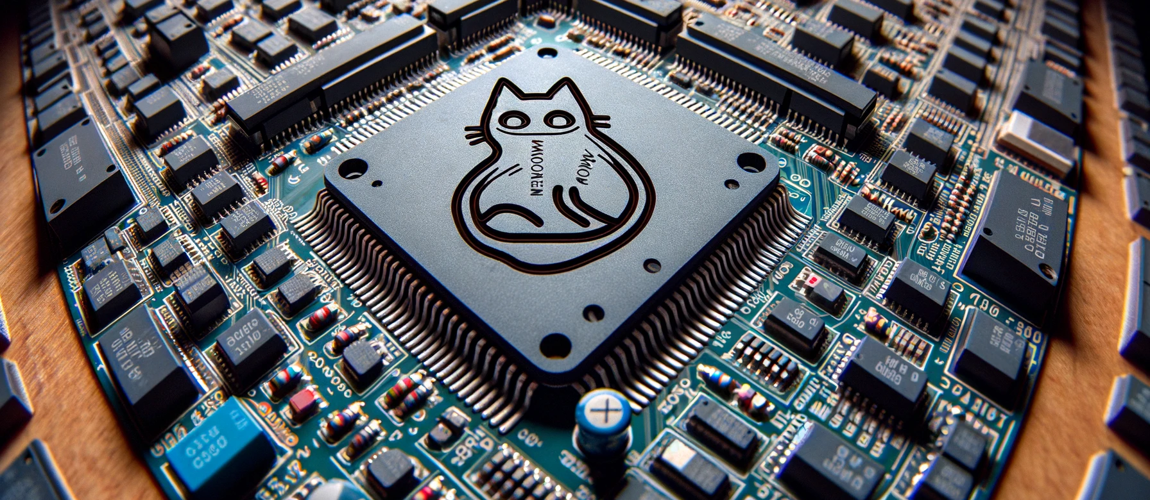
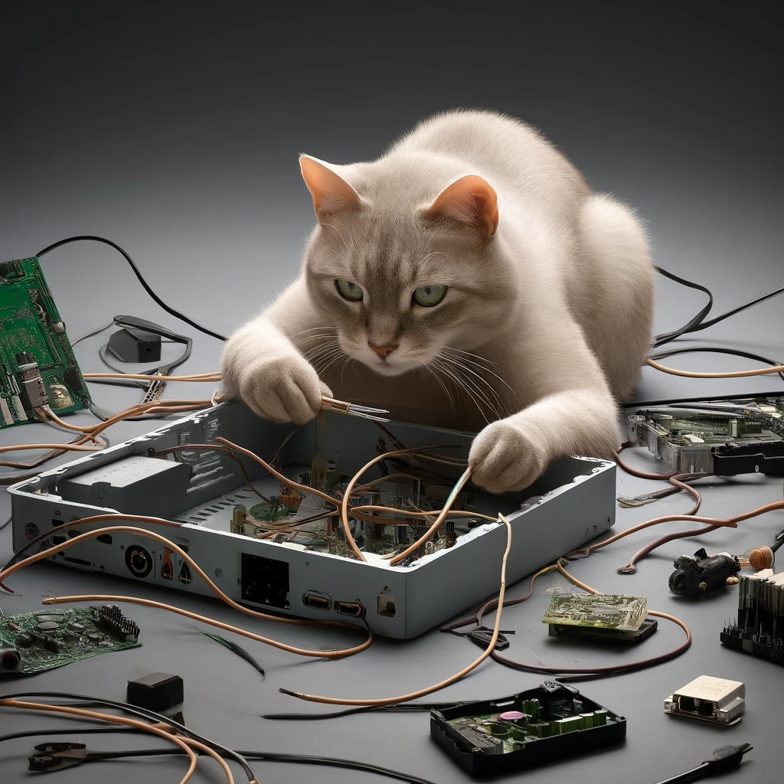
RECEIVING SSTV
COMPUTER
SOFTWARE
SSTV SIGNALS
A computer with a sound card, or even a phone
Many programs to choose from. MMSSTV is a good choice for Windows, or Robot36 for Android
Record over the air, or use one of many online SDR radios to tune in

Slide 19
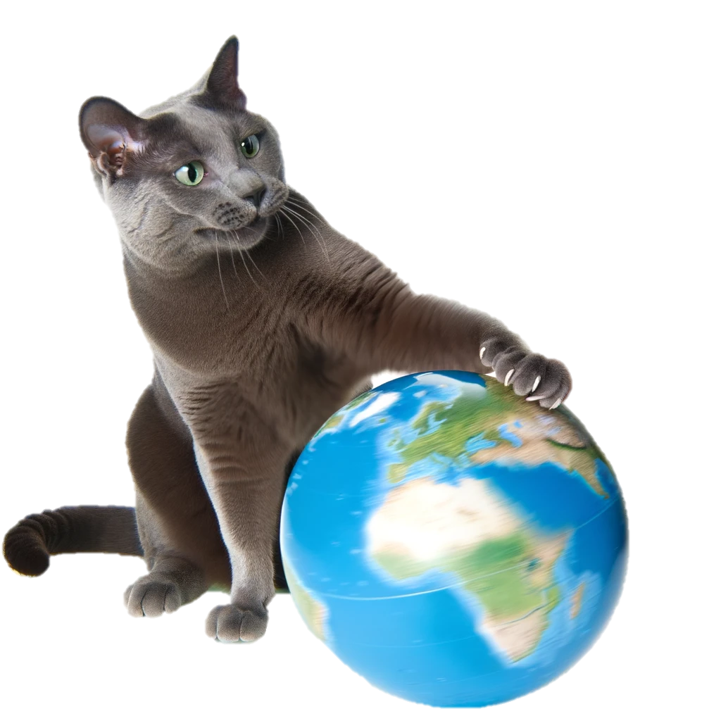
TYPICAL SSTV FREQUENCIES
Hams like to use specific frequencies for SSTV traffic
80 meters – 3.845Mhz
40 meters – 7.171Mhz
20 meters – 14.230Mhz
15 meters – 21.340Mhz
10 meters – 28.680

Slide 20
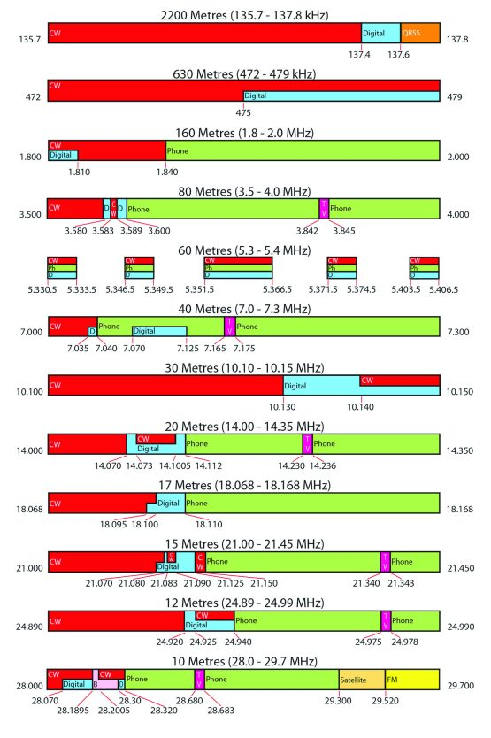
TRANSMITTING SSTV
LICENSE
Any license will grant some bands, but you’re going to want to upgrade to General or Extra to use the lower bands
POWER
You can transmit at as high of a power as allowed for the band, but be mindful of causing interference
IDENTIFICATION
When transmitting SSTV, most hams will overlay their callsign on the image being transmitted. Some programs will template this for you

Slide 21
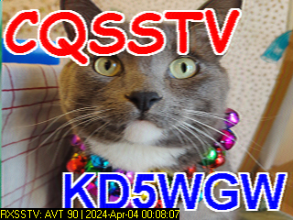
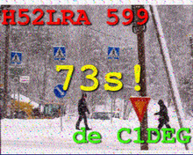
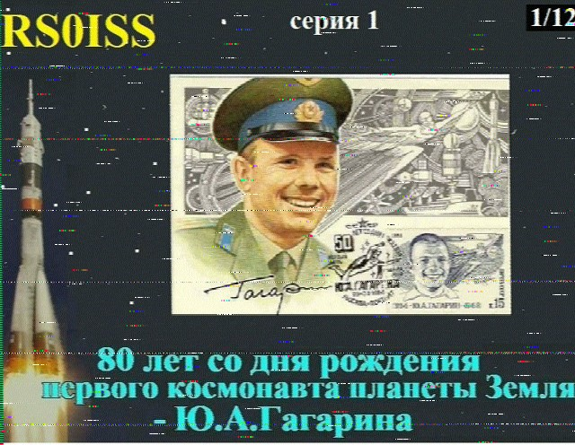
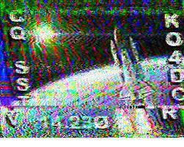
EXAMPLES

Slide 22
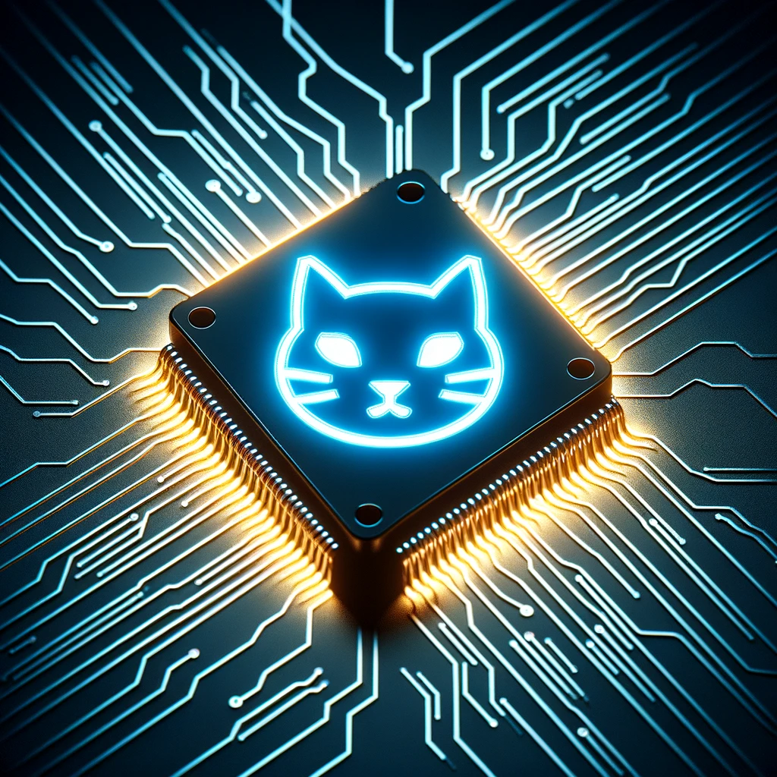
WHY TRANSMIT?
CONNECT
A fun way to connect without needing to use voice
INNOVATE
Try new methods or modes
Improve upon current ones
CREATE
Create unique images
Share your current view

Slide 23
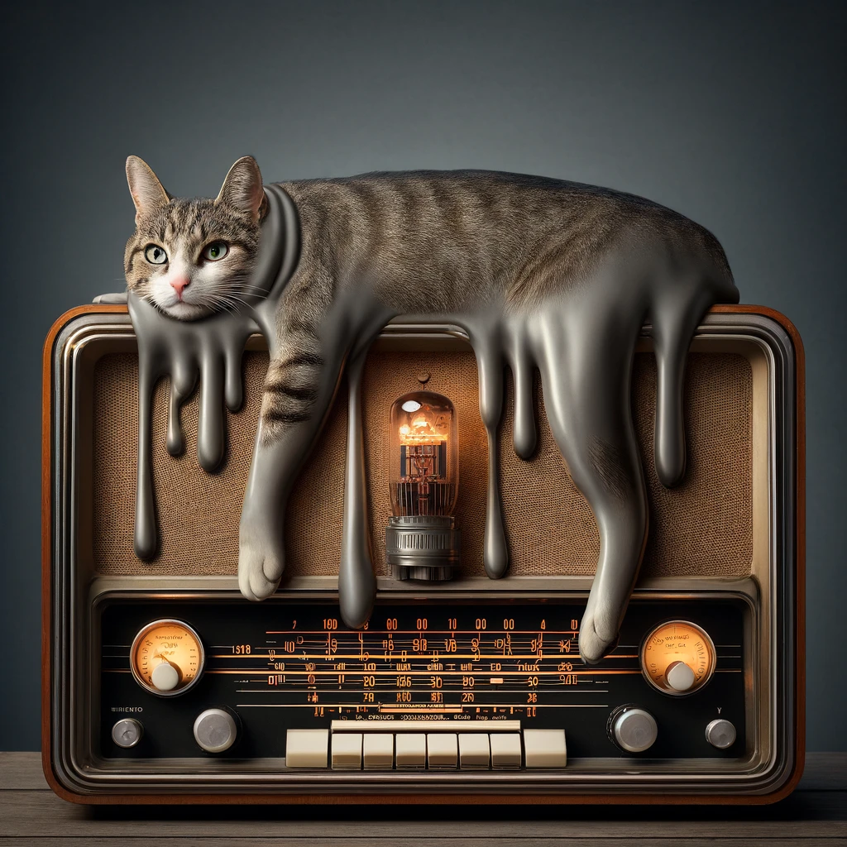
CHALLENGES AND LIMITATIONS
Transferring images is slow and can take considerable time
High power transmission can put considerable heat load on your radio equipment
Even with error correction, images can arrive out of sync or with significant artifacts
Higher license classes needed to access all of the bands
Much of the PC software is ancient, but functional

Slide 24
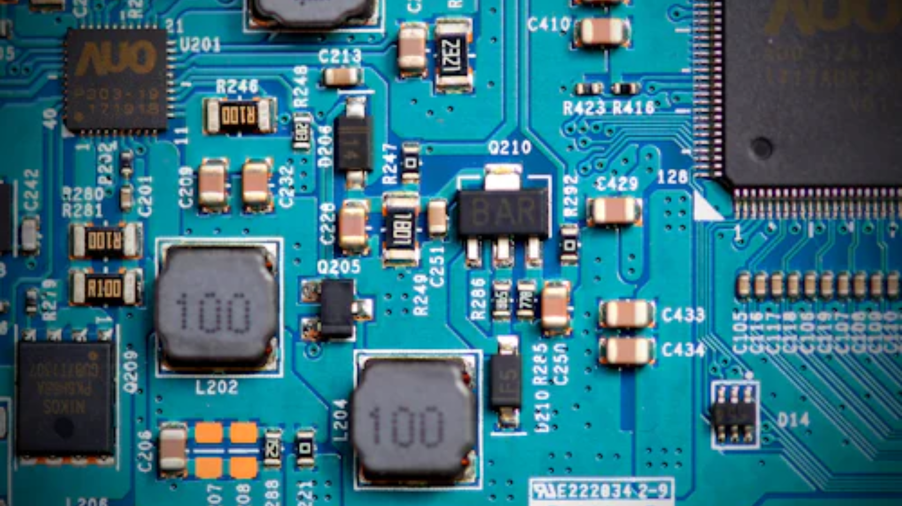
HARDWARE FUN

Slide 25
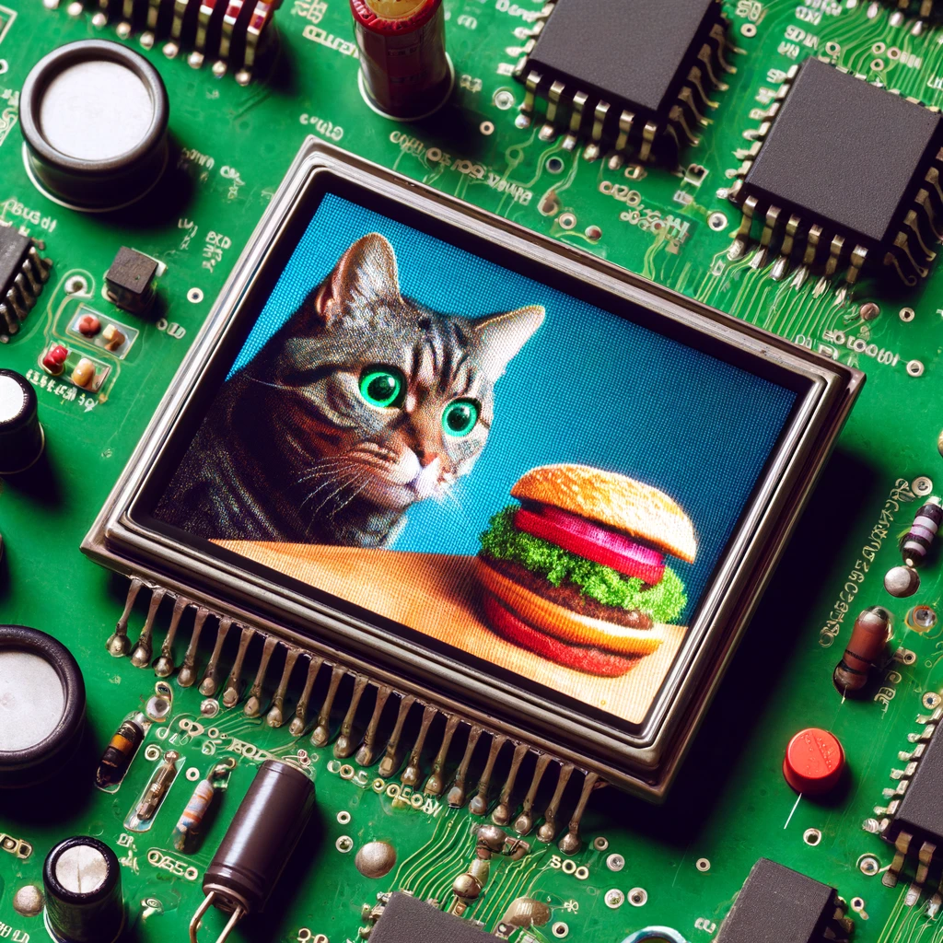
AN SSTV BADGE?
Of course I’m going to make this into a badge
LCD screen
Microphone
Microcontroller

Slide 26
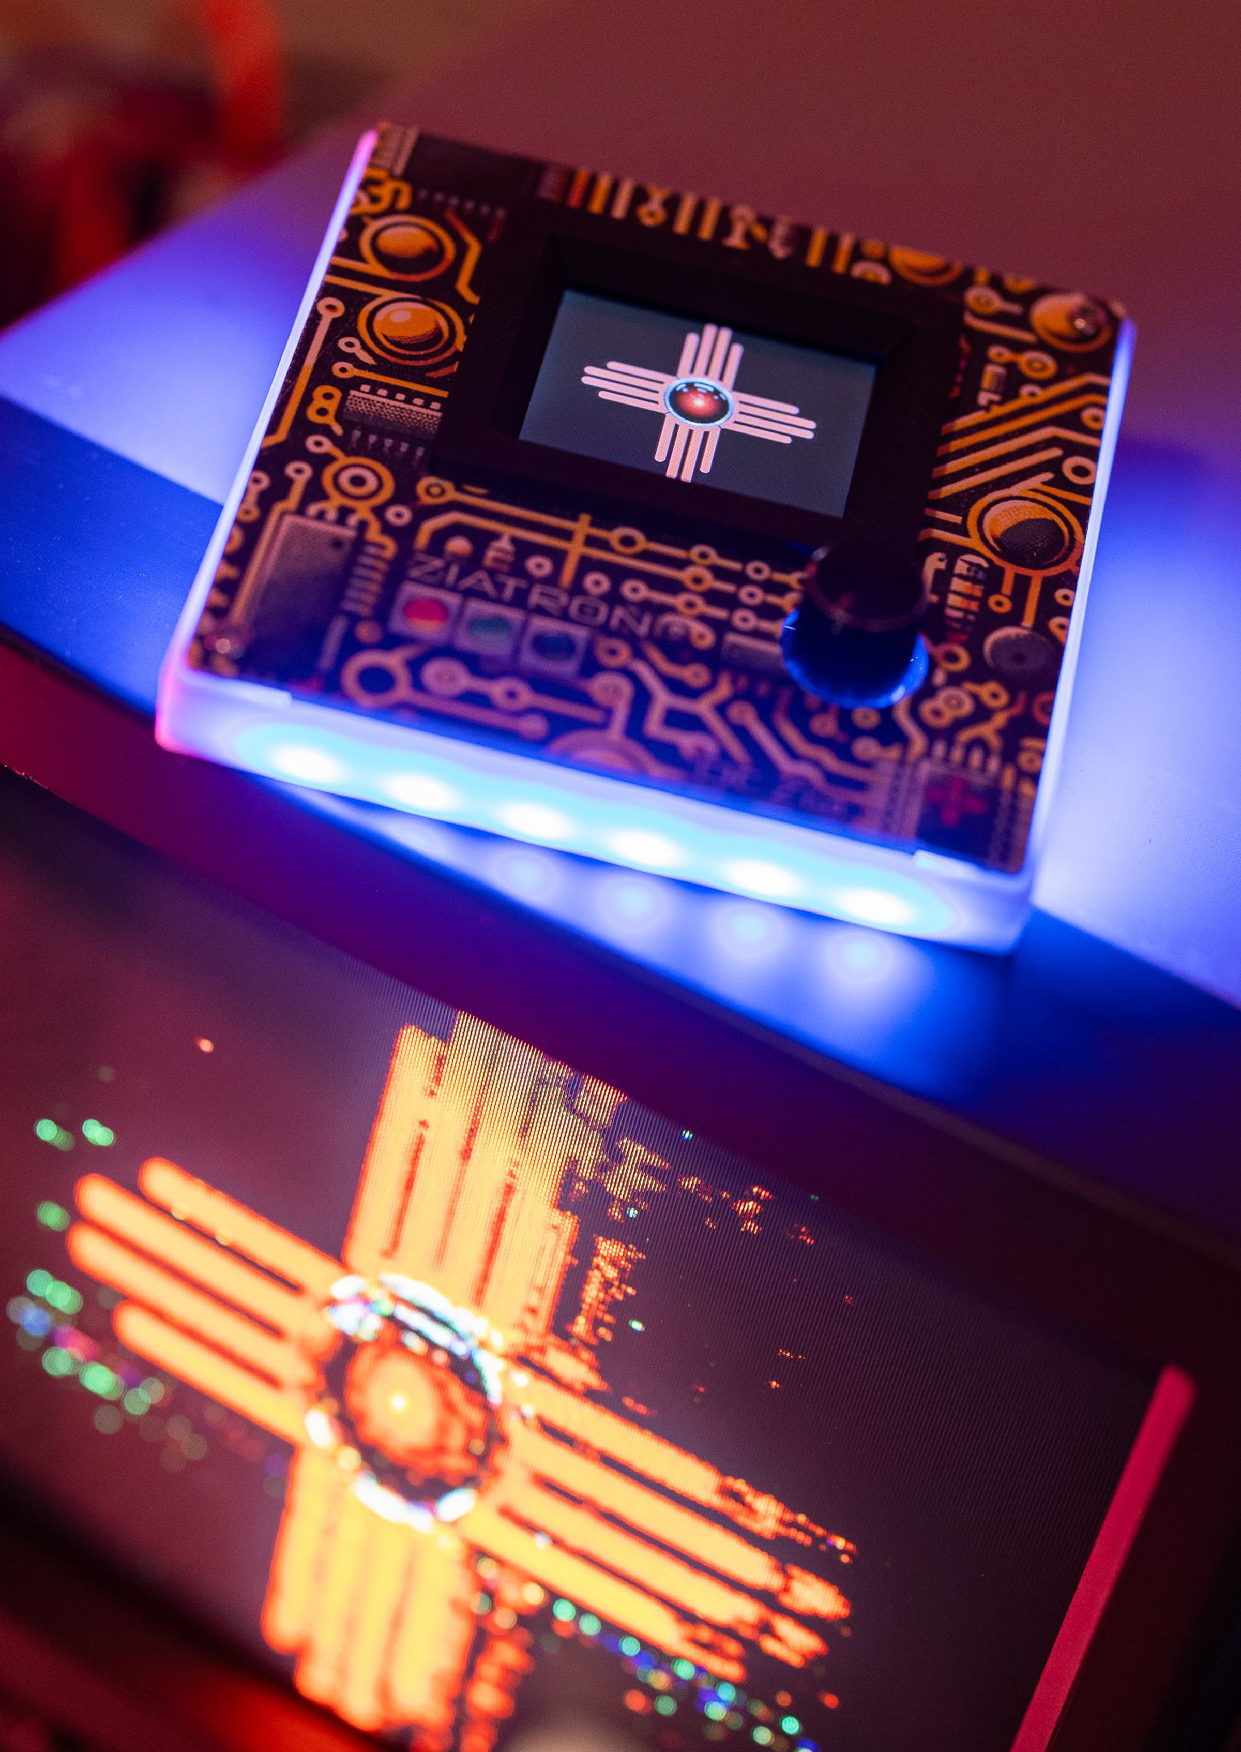
THE BADGE
DCZia group came together to design and build this badge
Runs off 3 AAA batteries
I2S Microphone and speaker
RP2040 microcontroller (raspberry pi pico)
Small screen
MicroSD socket
Lots of 3D printed parts

Slide 27
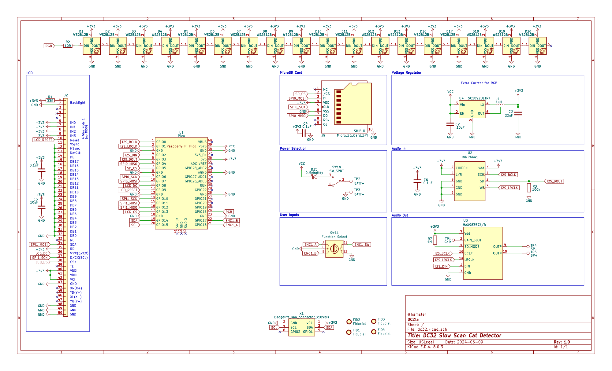
HARDWARE DESIGN

Slide 28
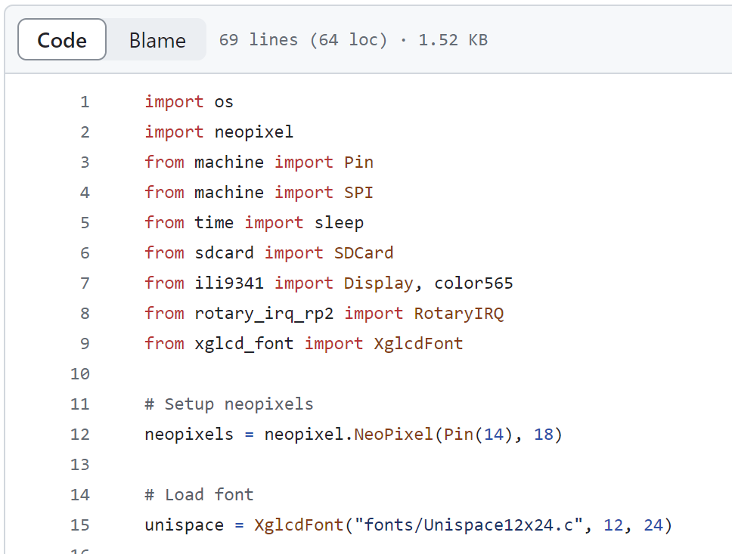
PROGRAMMING
Want to lower the barrier for entry for others to contribute
Started with CircuitPython
- Issues with display
Currently using MicroPython
Open source, seeking contributions
https://github.com/dczia/Defcon32-Badge

Slide 29
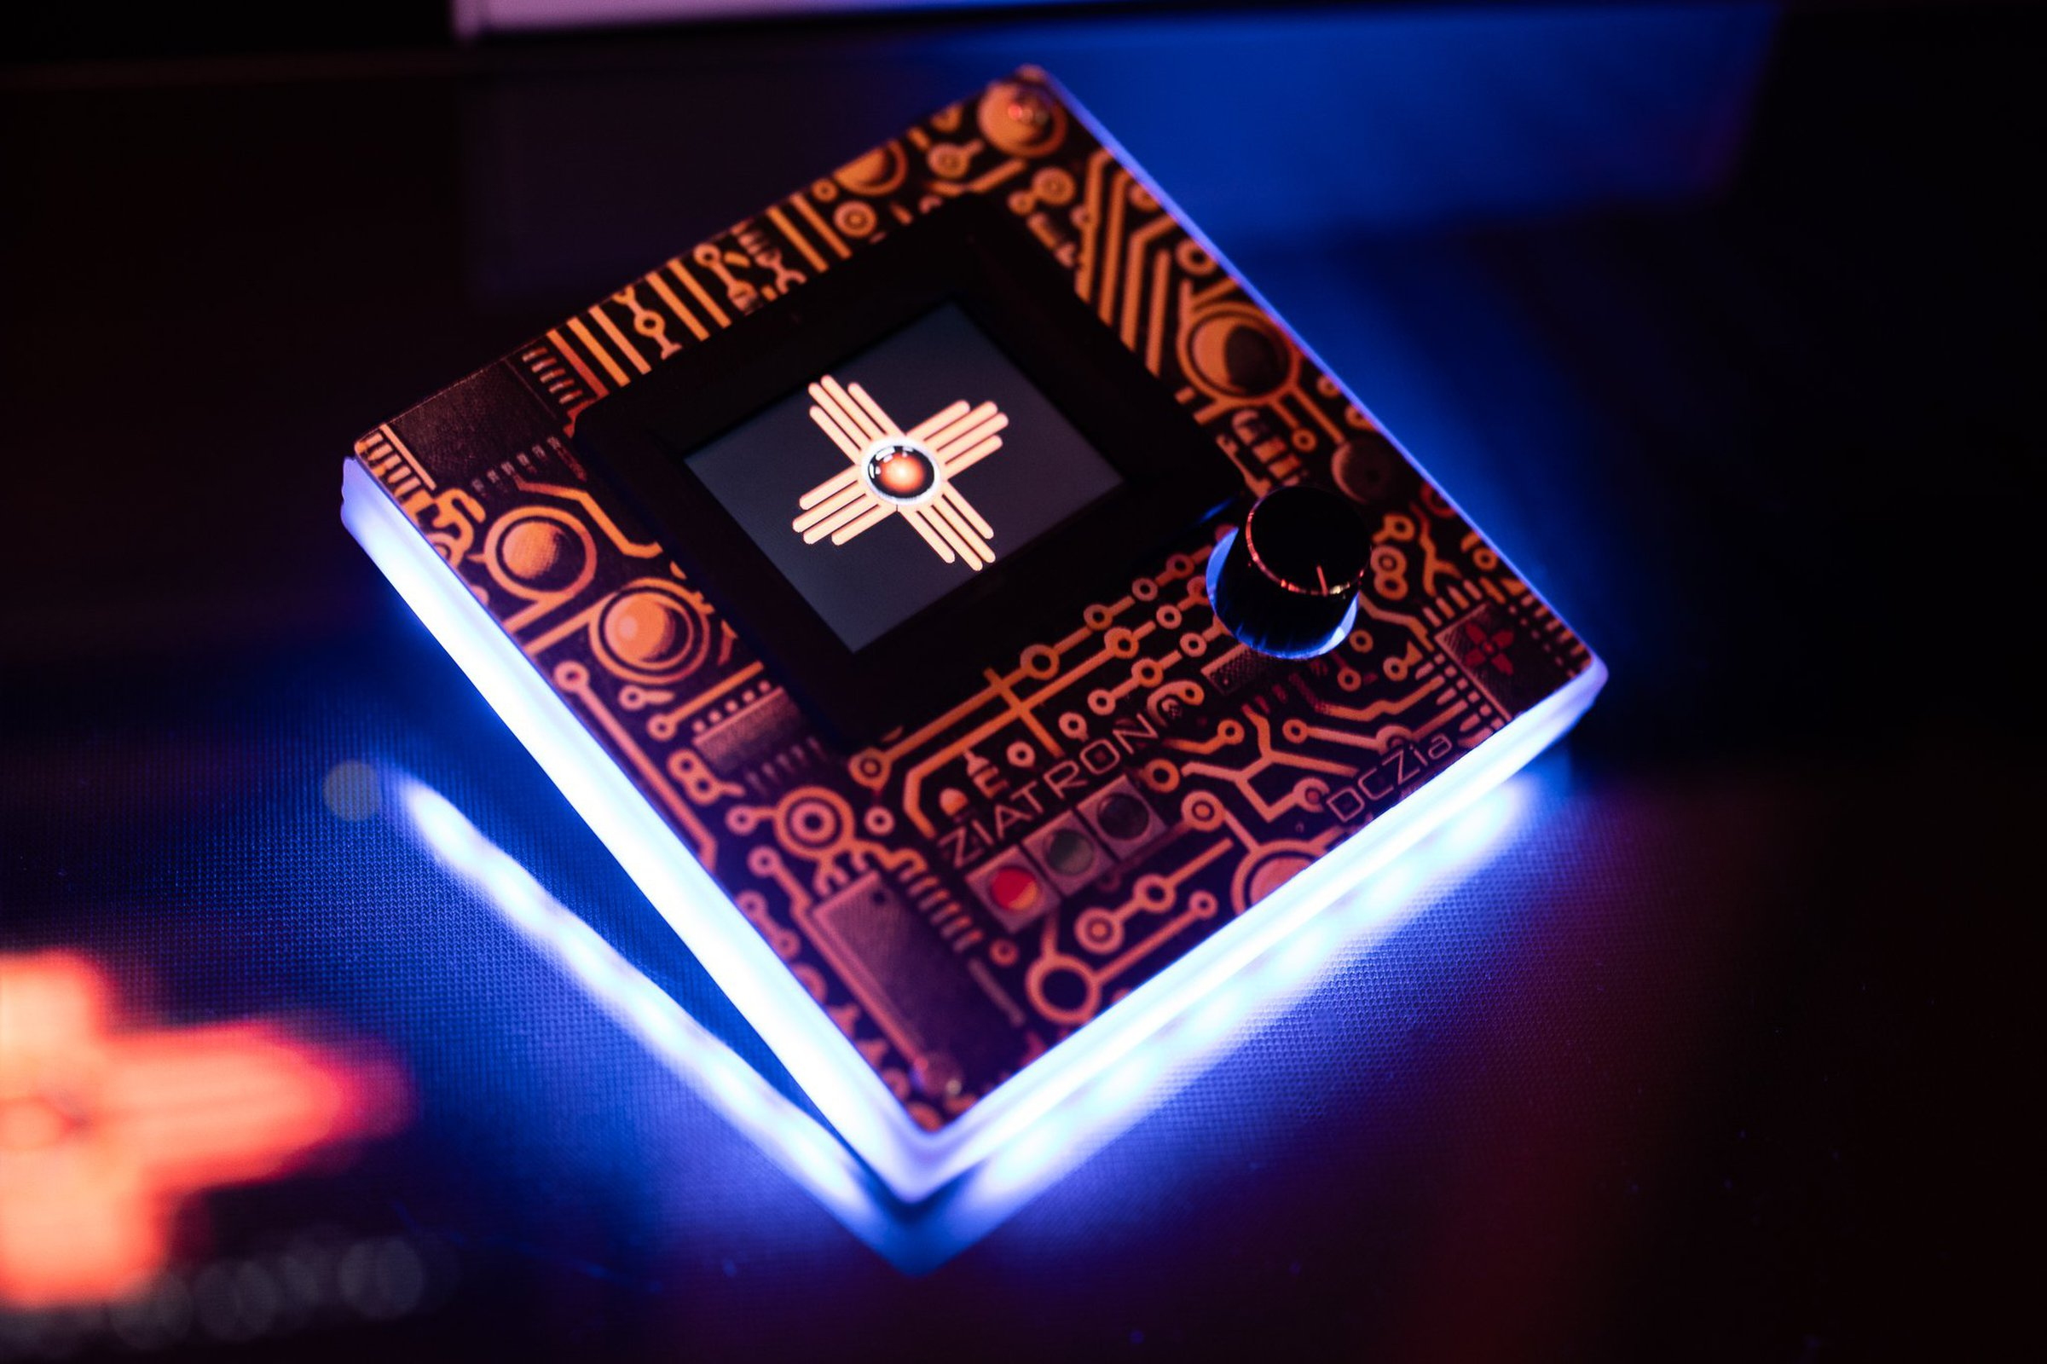
BADGE STATUS
Hardware came together late and team has not had much time to get everything working
Can encode an image – but in less than real time
MicroPython’s audio handling less than performant
Will be optimizing in C and creating some Python modules after con

Slide 30

QUESTIONS?

